Slide 1
Cost Models
NIST Internal Presentation by Ray Perlner
Tuesday August 11, 2020

Slide 2
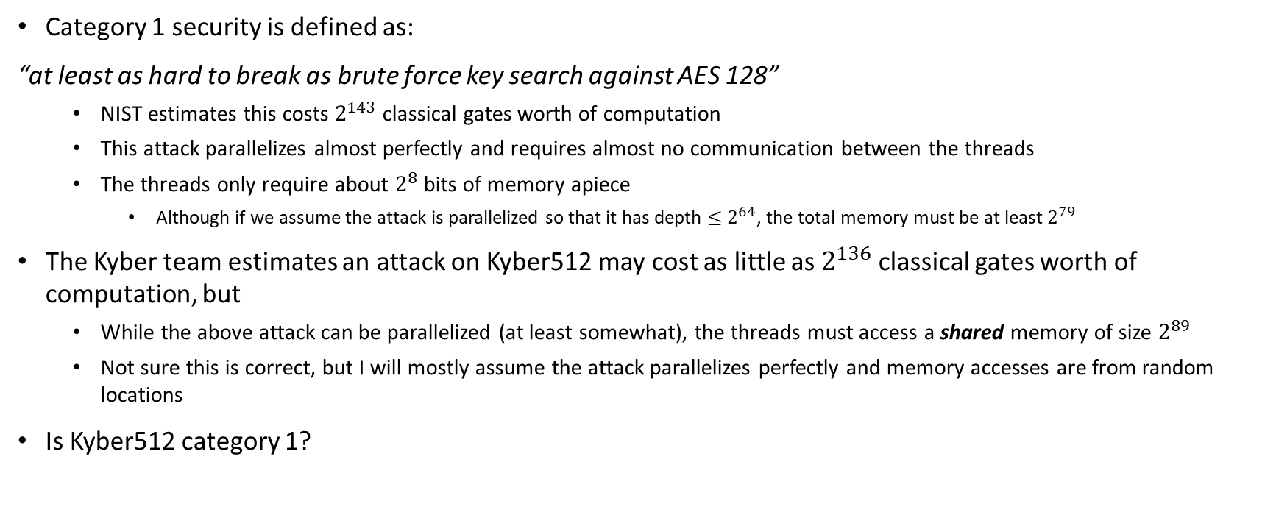
The Question that Started This
Category 1 security is defined as:
“at least as hard to break as brute force key search against AES 128”
  NIST estimates this costs $2^{143}$ classical gates worth of computation
  This attack parallelizes almost perfectly and requires almost no communication between the threads
  The threads only require about $2^{8}$ bits of memory apiece
    Although if we assume the attack is parallelized so that it has depth $≤2^{64}$, the total memory must be at least $2^{79}$
The Kyber team estimates an attack on Kyber512 may cost as little as $2^{136}$ classical gates worth of computation, but
  While the above attack can be parallelized (at least somewhat), the threads must access a shared memory of size $2^{89}$
  Not sure this is correct, but I will mostly assume the attack parallelizes perfectly and memory accesses are from random locations
Is Kyber512 category 1?

Slide 3
Classical or Quantum?
For categories 1, 3, 5, barring nongeneric quantum speedup (e.g. Shor, Kuperberg)
  The classical attack is almost always the main concern
  This is because AES key search is about as Groverizable as an algorithm can be
This started with a dispute about category 1, so we’ll mostly focus on classical attacks

Slide 4
Models to Consider
RAM model
Nonlocal gate model
Time × Area
Time × Volume
Custom models

Slide 5
RAM Model
Based on assembly instructions for typical CPUs
  Assume unit cost to read or write from any memory location, regardless of the memory size
  Assume that the contents of a memory location can be used to address another memory location
  Typically the cost is arrived at by counting instructions (which in turn can be costed in bit operations/gates)
  Can consider multithreading in which case we can consider also
    “Width” – Total memory size
    “Depth” – Number of operations per thread
This is the most common way to cost classical attacks and classical algorithms in general
Not clear how well it translates to extremely large distributed computations (The closest thing to a realistic model of the attacks we’re talking about)

Slide 6
Nonlocal Gate Model
Write the computation as a binary circuit with, say, AND and XOR gates.
  Assume that gates can be performed between any two memory locations at unit cost
  But, you can’t use the contents of any memory location to decide which gate to perform later on
When generalized to 2-qubit quantum gates, this is the most common way to cost quantum attacks
To simulate a single threaded memory access, gates will have to touch every memory location
  Cost is proportional to the size of the memory!
For algorithms that can be parallelized, so memory per thread is small
  Nonlocal Gate Model is equivalent to RAM model up to log factors in memory size: See https://arxiv.org/abs/1207.2307

Slide 7
Time × Area
Same as nonlocal gate model, but
  Assume memory locations are arranged 2-dimensionally
  Gates can only be performed between nearest neighbor memory locations
  Rather than counting gates, we multiply the number of memory locations by the circuit depth to compute cost
Dan Bernstein’s favorite model
Makes sense if
  heat dissipation per gate,
  density of gates per memory location per time
are constant as computation size scales
Makes less sense otherwise
Even if the algorithm parallelizes, random access to memory costs square root of memory size
Local memory access is essentially unit cost

Slide 8
Time × Volume
Same as nonlocal gate model, but
  Assume memory locations are arranged 3-dimensionally
  Gates can only be performed between nearest neighbor memory locations
  Rather than counting gates, we multiply the number of memory locations by the circuit depth to compute cost
Even if the algorithm parallelizes, random access to memory costs cube root of memory size
Local memory access is essentially unit cost

Slide 9
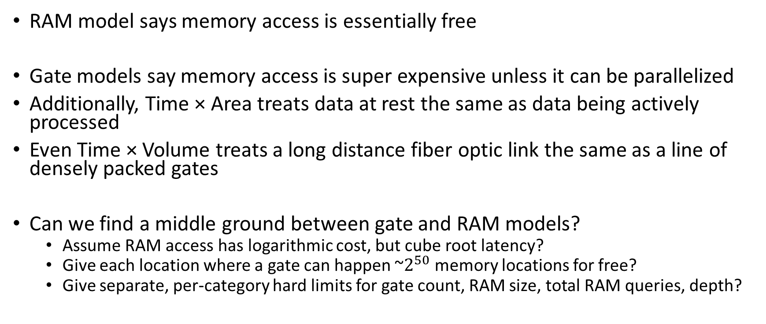
Custom Models
RAM model says memory access is essentially free
Gate models say memory access is super expensive unless it can be parallelized
Additionally, Time × Area treats data at rest the same as data being actively processed
Even Time × Volume treats a long distance fiber optic link the same as a line of densely packed gates
Can we find a middle ground between gate and RAM models?
  Assume RAM access has logarithmic cost, but cube root latency?
  Give each location where a gate can happen ~$2^{50}$ memory locations for free?
  Give separate, per-category hard limits for gate count, RAM size, total RAM queries, depth?

Slide 10
Part 2
How Hard are the Categories?

Slide 11
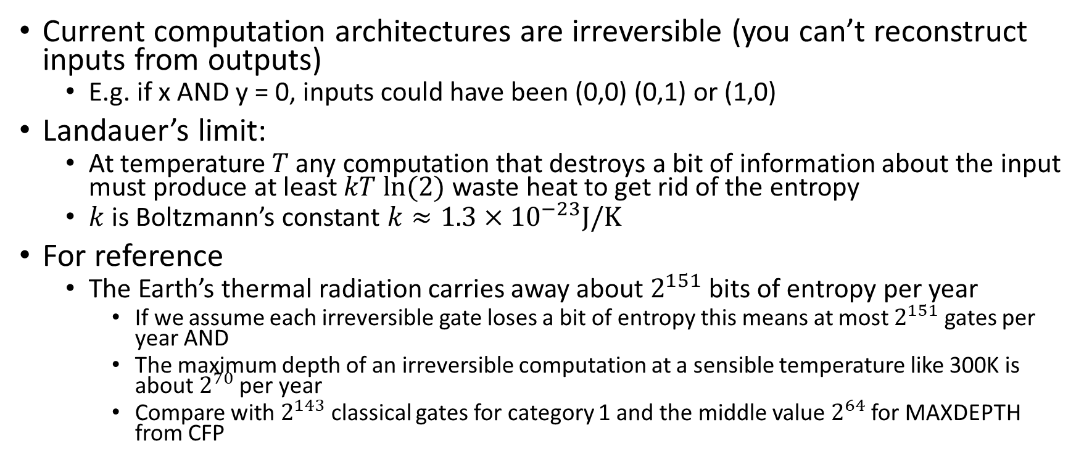
Landauer’s Limit
[Landauer 1961]
Current computation architectures are irreversible (you can’t reconstruct inputs from outputs)
  E.g. if x AND y = 0, inputs could have been (0,0) (0,1) or (1,0)
Landauer’s limit:
  At temperature $T$ any computation that destroys a bit of information about the input must produce at least $kT ln⁡(2)$ waste heat to get rid of the entropy
  $k$ is Boltzmann’s constant $k≈1.3×{10}^{−23}J/K$
For reference
  The Earth’s thermal radiation carries away about $2^{151}$ bits of entropy per year
    If we assume each irreversible gate loses a bit of entropy this means at most $2^{151}$ gates per year AND
    The maximum depth of an irreversible computation at a sensible temperature like 300K is about $2^{70}$ per year
    Compare with $2^{143}$ classical gates for category 1 and the middle value $2^{64}$ for MAXDEPTH from CFP

Slide 12
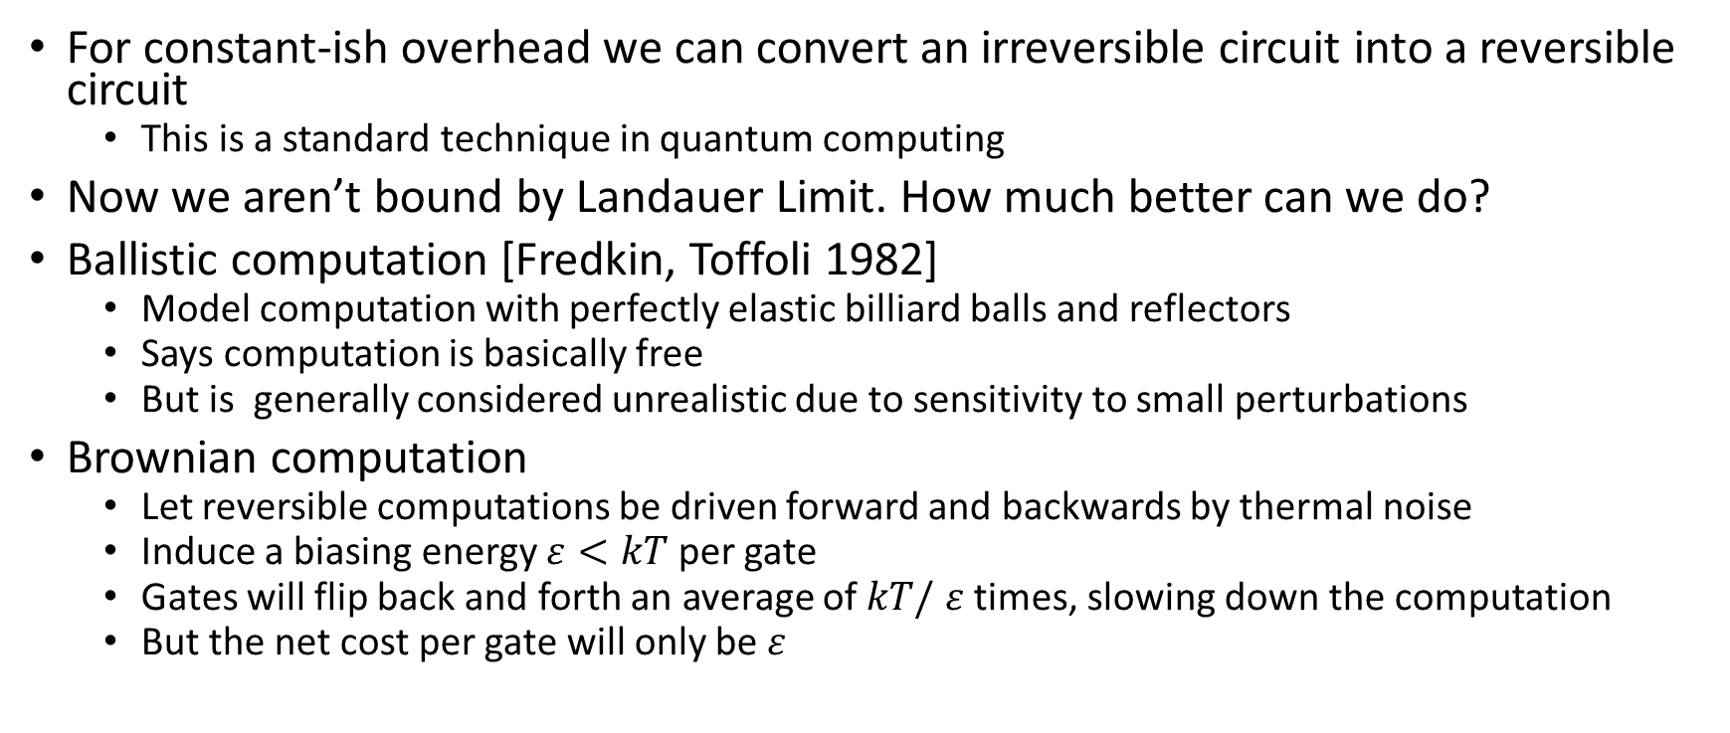
Brownian Computation
[Bennett 1973]
For constant-ish overhead we can convert an irreversible circuit into a reversible circuit
  This is a standard technique in quantum computing
Now we aren’t bound by Landauer Limit. How much better can we do?
Ballistic computation [Fredkin, Toffoli 1982]
  Model computation with perfectly elastic billiard balls and reflectors
  Says computation is basically free
  But is generally considered unrealistic due to sensitivity to small perturbations
Brownian computation
  Let reversible computations be driven forward and backwards by thermal noise
  Induce a biasing energy $ε<kT$ per gate
  Gates will flip back and forth an average of $kT/$ $ε$ times, slowing down the computation
  But the net cost per gate will only be $ε$

Slide 13
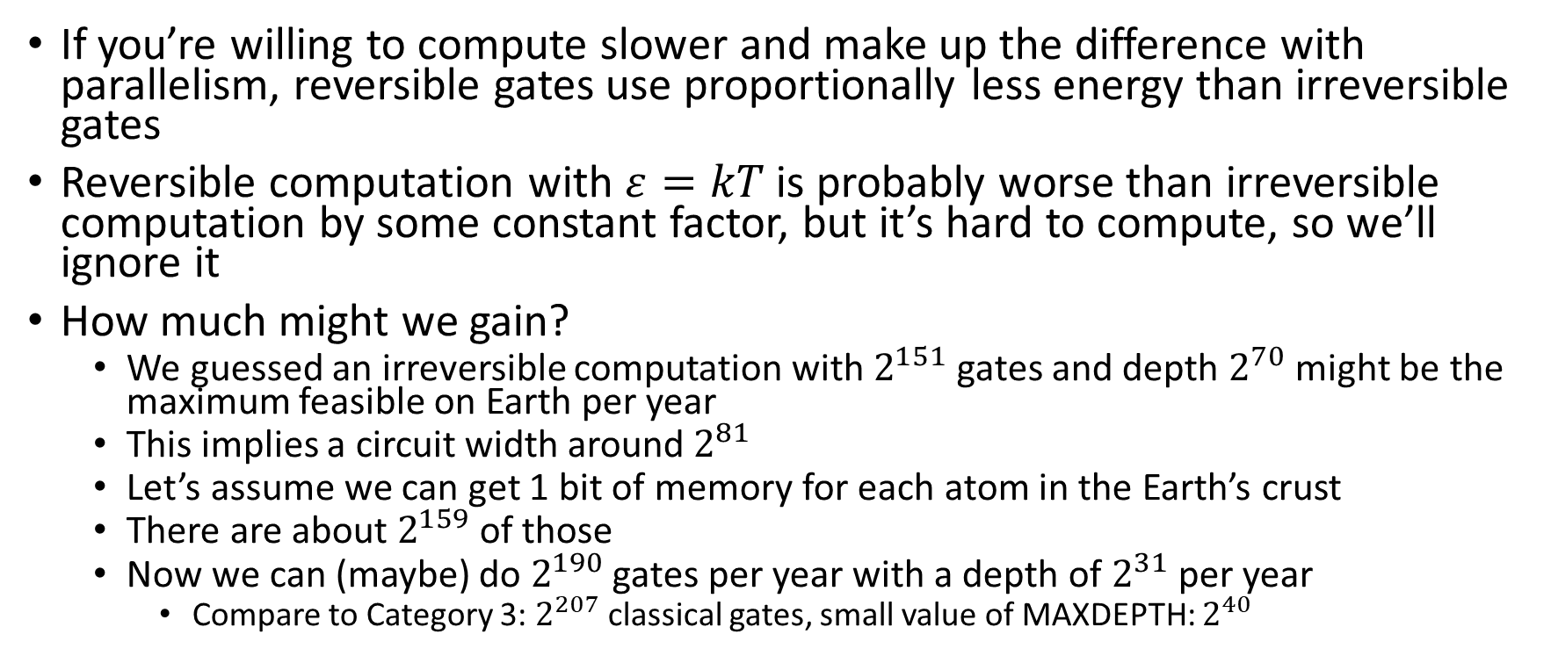
Implications of Brownian Computation
If you’re willing to compute slower and make up the difference with parallelism, reversible gates use proportionally less energy than irreversible gates
Reversible computation with $ε=kT$ is probably worse than irreversible computation by some constant factor, but it’s hard to compute, so we’ll ignore it
How much might we gain?
  We guessed an irreversible computation with $2^{151}$ gates and depth $2^{70}$ might be the maximum feasible on Earth per year
  This implies a circuit width around $2^{81}$
  Let’s assume we can get 1 bit of memory for each atom in the Earth’s crust
  There are about $2^{159}$ of those
  Now we can (maybe) do $2^{190}$ gates per year with a depth of $2^{31}$ per year
    Compare to Category 3: $2^{207}$ classical gates, small value of MAXDEPTH: $2^{40}$

Slide 14
Unpowered Brownian Computation
“Classical Grover”
[Perlner, Liu 2017]
For AES key search and similar, there’s another way to use classical reversible computation
Make tiny computing units that randomly explore the AES key space driven by thermal noise, and only dissipate energy when they find the correct key
Can be made to induce transition to final state in their neighbors
Energy cost is basically the same as for Quantum Grover Search
Memory can be reduced to a reasonable amount by speeding up computation
  Speed is proportional to temperature
  Computation at arbitrarily high temperatures is probably at least as hard as quantum computation, so we can maybe ignore this option for the purpose of dealing with classical security levels

Slide 15
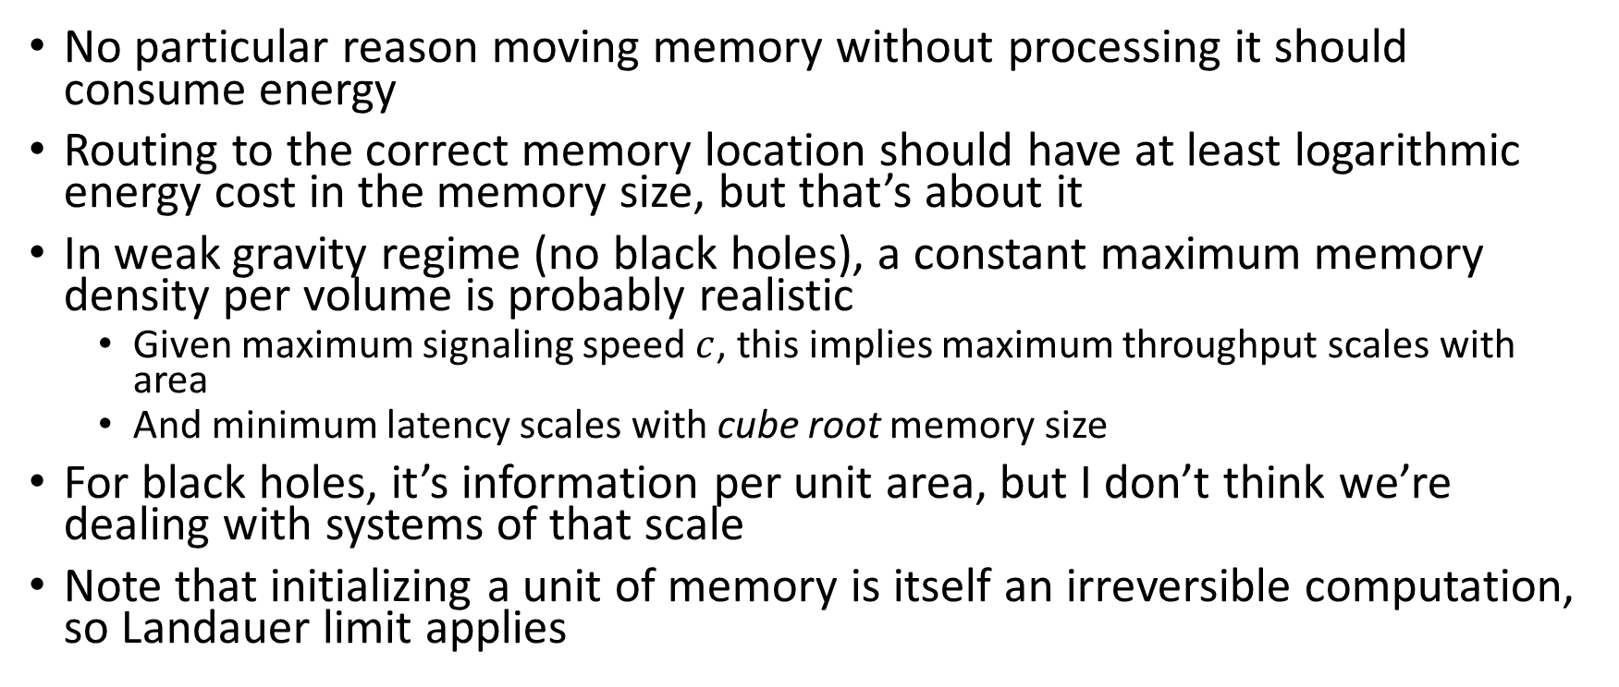
What about Fundamental Limits on Memory?
No particular reason moving memory without processing it should consume energy
Routing to the correct memory location should have at least logarithmic energy cost in the memory size, but that’s about it
In weak gravity regime (no black holes), a constant maximum memory density per volume is probably realistic
  Given maximum signaling speed $c$, this implies maximum throughput scales with area
  And minimum latency scales with cube root memory size
For black holes, it’s information per unit area, but I don’t think we’re dealing with systems of that scale
Note that initializing a unit of memory is itself an irreversible computation, so Landauer limit applies

Slide 16
OK,
But What about Real Technology?
Note: Commercial products are mentioned here for informational purposes. This is not an endorsement by NIST of any of the mentioned products.

Slide 17
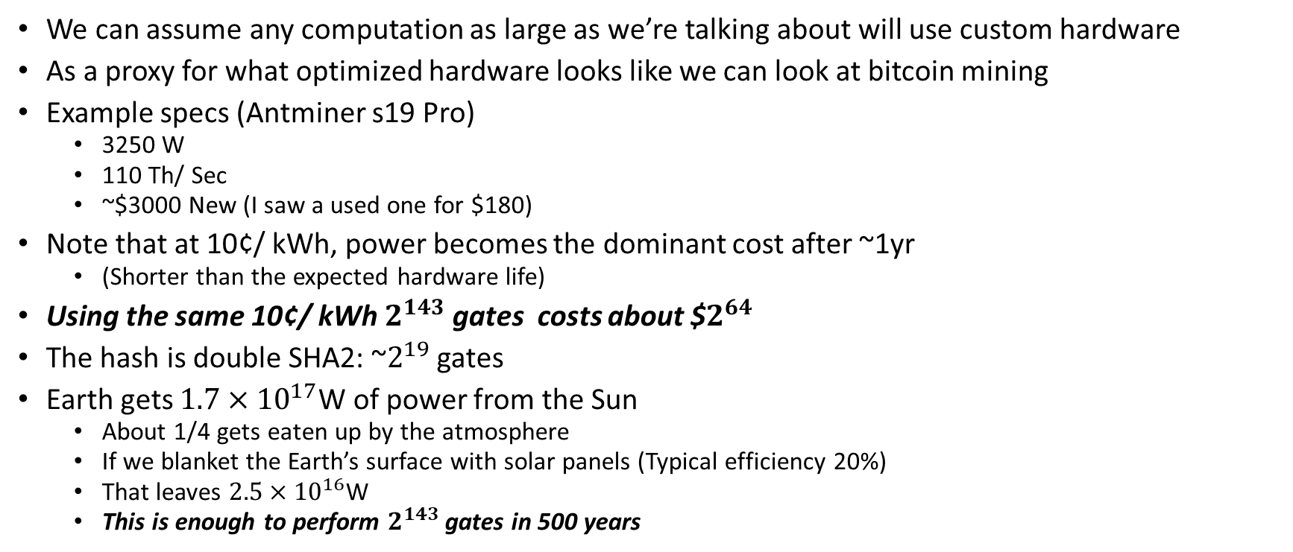
How Much Does Computation Cost?
We can assume any computation as large as we’re talking about will use custom hardware
As a proxy for what optimized hardware looks like we can look at bitcoin mining
Example specs (Antminer s19 Pro)
  3250 W
  110 Th/ Sec
  ~$3000 New (I saw a used one for $180)
Note that at 10¢/ kWh, power becomes the dominant cost after ~1yr
  (Shorter than the expected hardware life)
Using the same 10¢/ kWh $2^{143}$ gates costs about $$2^{64}$
The hash is double SHA2: ~$2^{19}$ gates
Earth gets $1.7×{10}^{17}$W of power from the Sun
  About 1/4 gets eaten up by the atmosphere
  If we blanket the Earth’s surface with solar panels (Typical efficiency 20%)
  That leaves $2.5×{10}^{16}$W
  This is enough to perform $2^{143}$ gates in 500 years

Slide 18
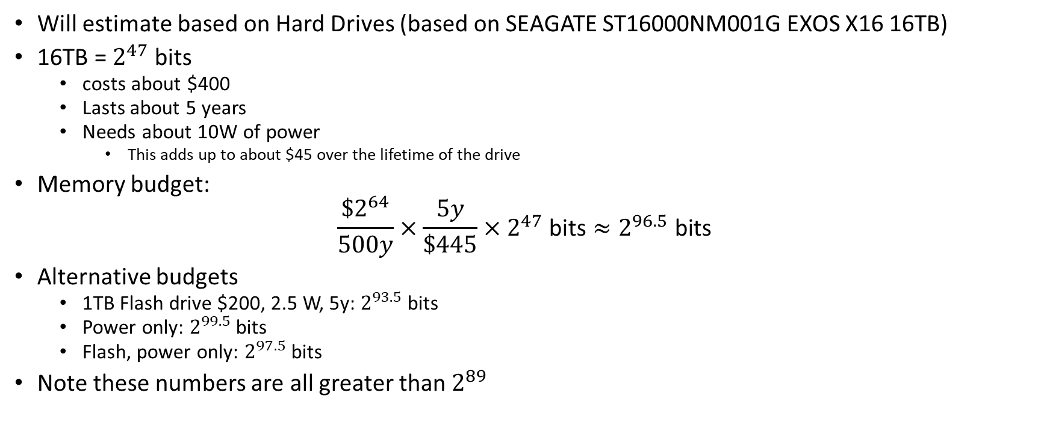
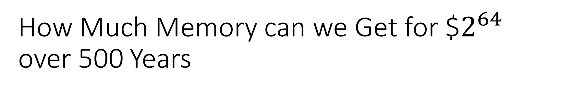
How Much Memory can we Get for $$2^{64}$ over 500 Years
Will estimate based on Hard Drives (based on SEAGATE ST16000NM001G EXOS X16 16TB)
16TB = $2^{47}$ bits
  costs about $400
  Lasts about 5 years
  Needs about 10W of power
    This adds up to about $45 over the lifetime of the drive
Memory budget:
$$\frac{\$2^{64}}{500y}×\frac{5y}{\$445}×2^{47} \text{bits}≈2^{96.5} \text{bits}$$
Alternative budgets
  1TB Flash drive $200, 2.5 W, 5y: $2^{93.5} \text{bits}$
  Power only: $2^{99.5} \text{bits}$
  Flash, power only: $2^{97.5} \text{bits}$
Note these numbers are all greater than $2^{89}$

Slide 19
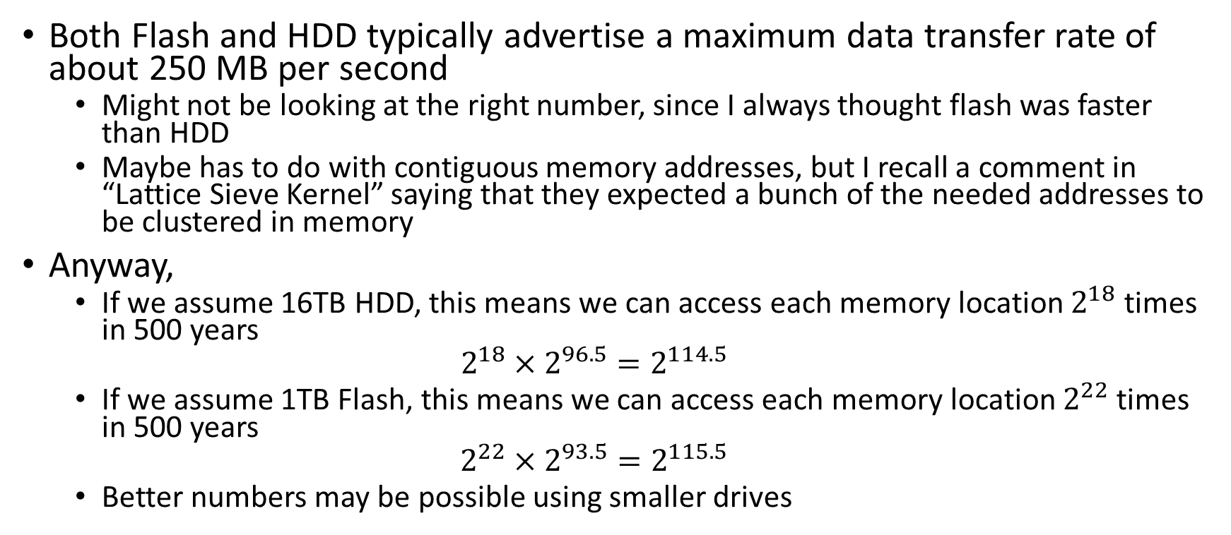
What about Memory Bandwidth?
Both Flash and HDD typically advertise a maximum data transfer rate of about 250 MB per second
  Might not be looking at the right number, since I always thought flash was faster than HDD
  Maybe has to do with contiguous memory addresses, but I recall a comment in “Lattice Sieve Kernel” saying that they expected a bunch of the needed addresses to be clustered in memory
Anyway,
  If we assume 16TB HDD, this means we can access each memory location $2^{18}$ times in 500 years
  $$2^{18}×2^{96.5}=2^{114.5}$$
  If we assume 1TB Flash, this means we can access each memory location $2^{22}$ times in 500 years
  $$2^{22}×2^{93.5}=2^{115.5}$$
  Better numbers may be possible using smaller drives

Slide 20
What about the Network?
Heat dissipation considerations demand that processors be distributed fairly evenly around the globe
If memory is truly random access, this means processors will need to access data an average of 10000 kilometers away
How much does it cost to send data 10000 km?
  This question is surprisingly hard to answer

Slide 21
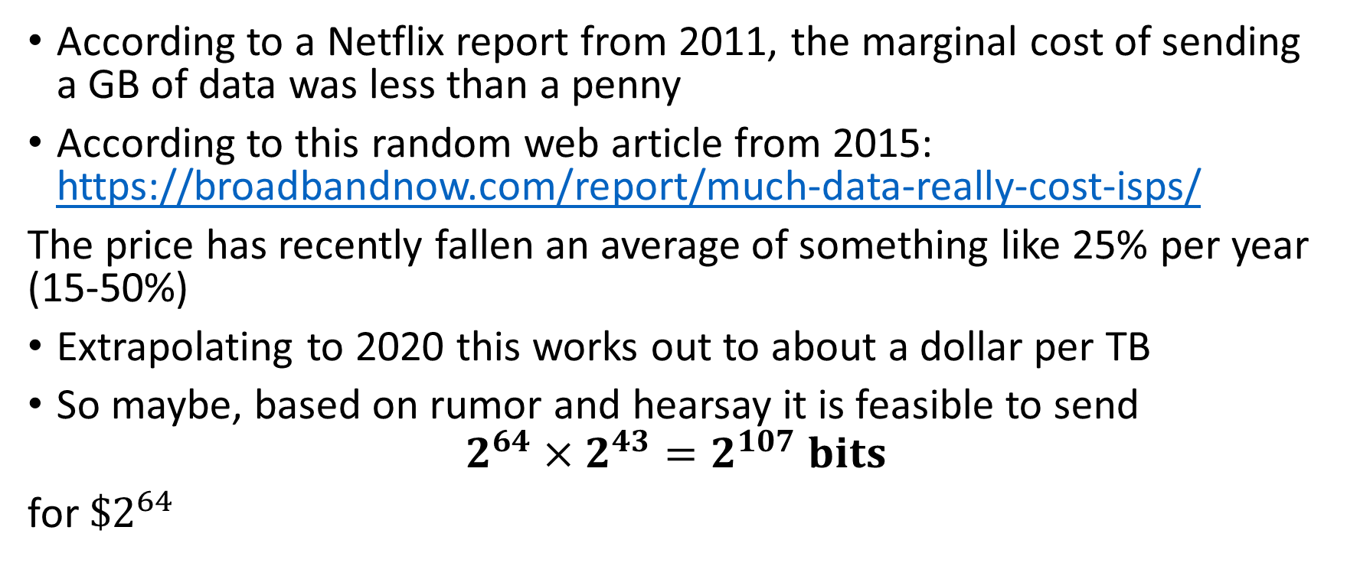
What ISPs (Allegedly) Pay for Bandwidth
According to a Netflix report from 2011, the marginal cost of sending a GB of data was less than a penny
According to this random web article from 2015: https://broadbandnow.com/report/much-data-really-cost-isps/
The price has recently fallen an average of something like 25% per year (15-50%)
Extrapolating to 2020 this works out to about a dollar per TB
So maybe, based on rumor and hearsay it is feasible to send
$$2^{64}×2^{43}=2^{107} bits$$
for ${\$2}^{64}$

Slide 22
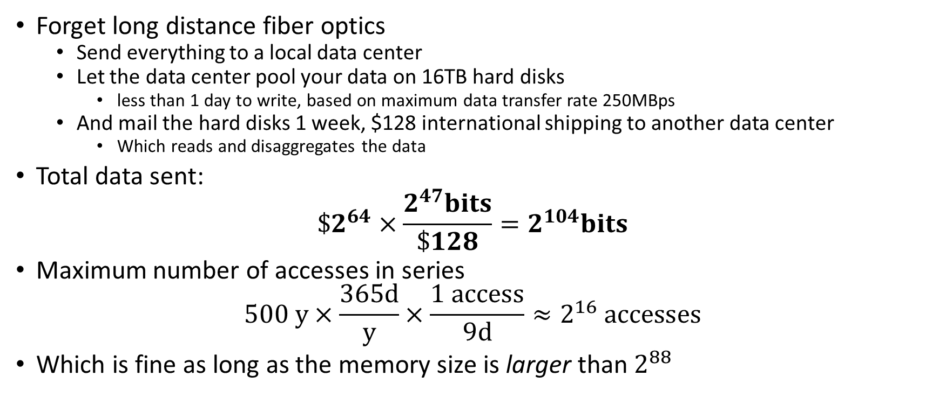
Just for Kicks:
A System that is Almost as Good
Forget long distance fiber optics
  Send everything to a local data center
  Let the data center pool your data on 16TB hard disks
    less than 1 day to write, based on maximum data transfer rate 250MBps
  And mail the hard disks 1 week, $128 international shipping to another data center
    Which reads and disaggregates the data
Total data sent:
$${\$2}^{64}×\frac{2^{47}bits}{\$128}=2^{104}bits$$
Maximum number of accesses in series
$$500 y×\frac{365d}{y}×\frac{1 access}{9d}≈2^{16} accesses$$
Which is fine as long as the memory size is larger than $2^{88}$

Slide 23
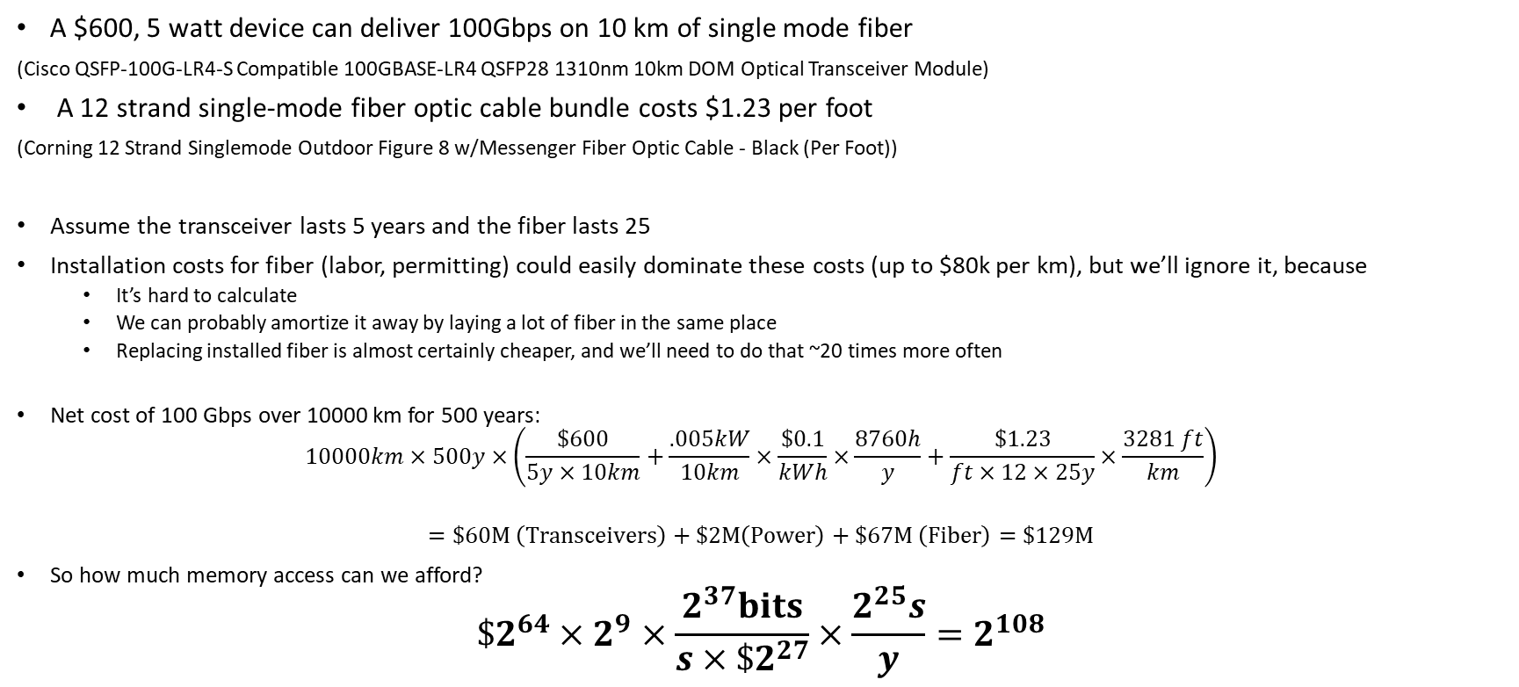
What if we Buy our own Equipment?
A $600, 5 watt device can deliver 100Gbps on 10 km of single mode fiber
(Cisco QSFP-100G-LR4-S Compatible 100GBASE-LR4 QSFP28 1310nm 10km DOM Optical Transceiver Module)
A 12 strand single-mode fiber optic cable bundle costs $1.23 per foot
(Corning 12 Strand Singlemode Outdoor Figure 8 w/Messenger Fiber Optic Cable - Black (Per Foot))
Assume the transceiver lasts 5 years and the fiber lasts 25
Installation costs for fiber (labor, permitting) could easily dominate these costs (up to $80k per km), but we’ll ignore it, because
  It’s hard to calculate
  We can probably amortize it away by laying a lot of fiber in the same place
  Replacing installed fiber is almost certainly cheaper, and we’ll need to do that ~20 times more often
Net cost of 100 Gbps over 10000 km for 500 years:
$$10000km×500y×\left(\frac{\$600}{5y×10km}+\frac{.005kW}{10km}×\frac{\$0.1}{kWh}×\frac{8760h}{y}+\frac{\$1.23}{ft×12×25y}×\frac{3281 ft}{km}\right)$$
$$=\$60M \left(Transceivers\right)+\$2M\left(Power\right)+\$67M \left(Fiber\right)=\$129M$$
So how much memory access can we afford?
$$\$2^{64}×2^{9}×\frac{2^{37}bits}{s×{\$2}^{27}}×\frac{2^{25}s}{y}=2^{108}$$

Slide 24
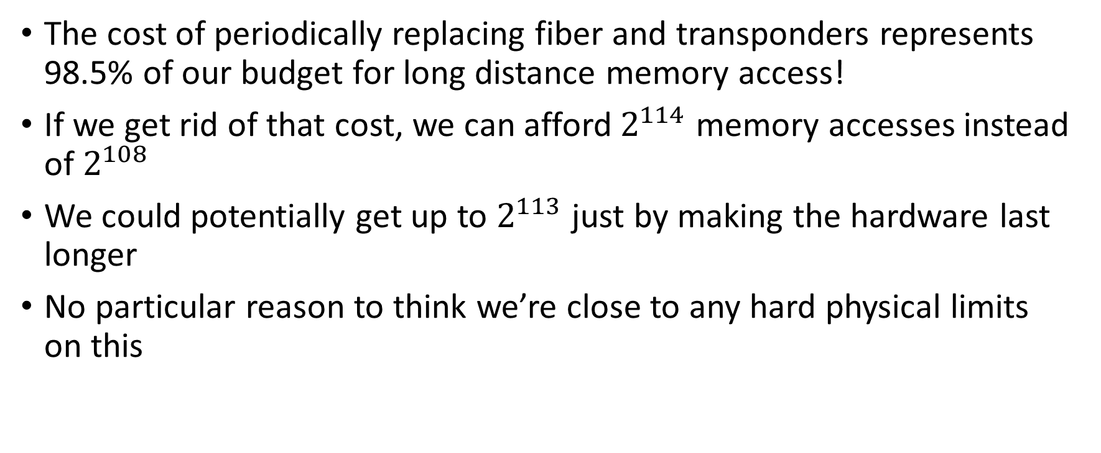
A Note about Hardware Cost
The cost of periodically replacing fiber and transponders represents 98.5% of our budget for long distance memory access!
If we get rid of that cost, we can afford $2^{114}$ memory accesses instead of $2^{108}$
We could potentially get up to $2^{113}$ just by making the hardware last longer
No particular reason to think we’re close to any hard physical limits on this

Slide 25
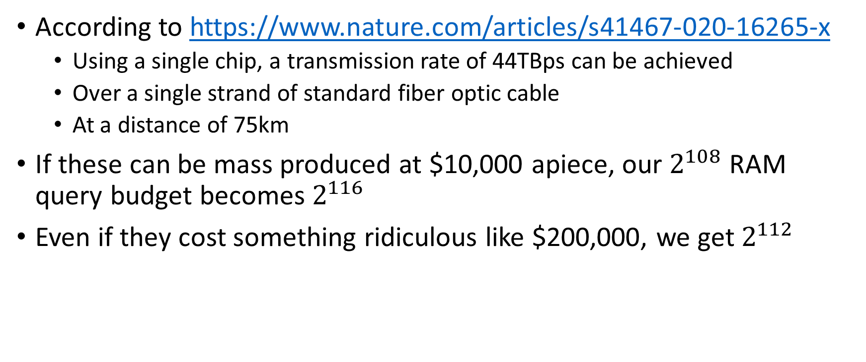
What if we Mass Produce our own Equipment?
According to https://www.nature.com/articles/s41467-020-16265-x
  Using a single chip, a transmission rate of 44TBps can be achieved
  Over a single strand of standard fiber optic cable
  At a distance of 75km
If these can be mass produced at $10,000 apiece, our $2^{108}$ RAM query budget becomes $2^{116}$
Even if they cost something ridiculous like $200,000, we get $2^{112}$

Slide 26
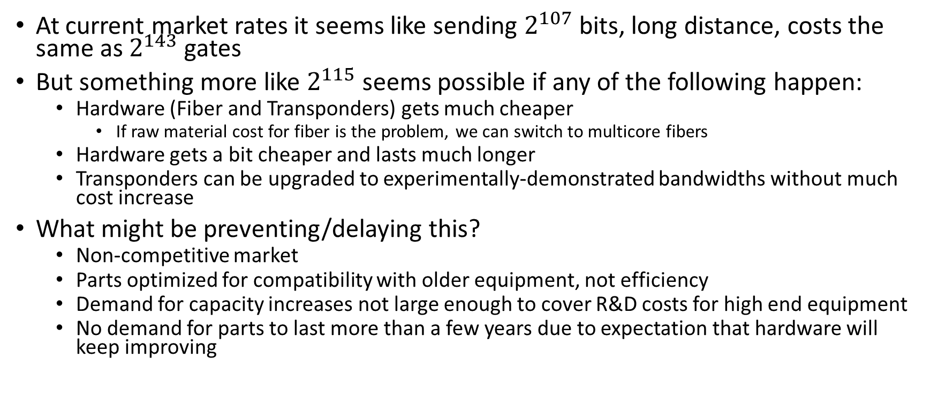
Why Communication May Cost More than it Should
At current market rates it seems like sending $2^{107}$ bits, long distance, costs the same as $2^{143}$ gates
But something more like $2^{115}$ seems possible if any of the following happen:
  Hardware (Fiber and Transponders) gets much cheaper
    If raw material cost for fiber is the problem, we can switch to multicore fibers
  Hardware gets a bit cheaper and lasts much longer
  Transponders can be upgraded to experimentally-demonstrated bandwidths without much cost increase
What might be preventing/delaying this?
  Non-competitive market
  Parts optimized for compatibility with older equipment, not efficiency
  Demand for capacity increases not large enough to cover R&D costs for high end equipment
  No demand for parts to last more than a few years due to expectation that hardware will keep improving

Slide 27
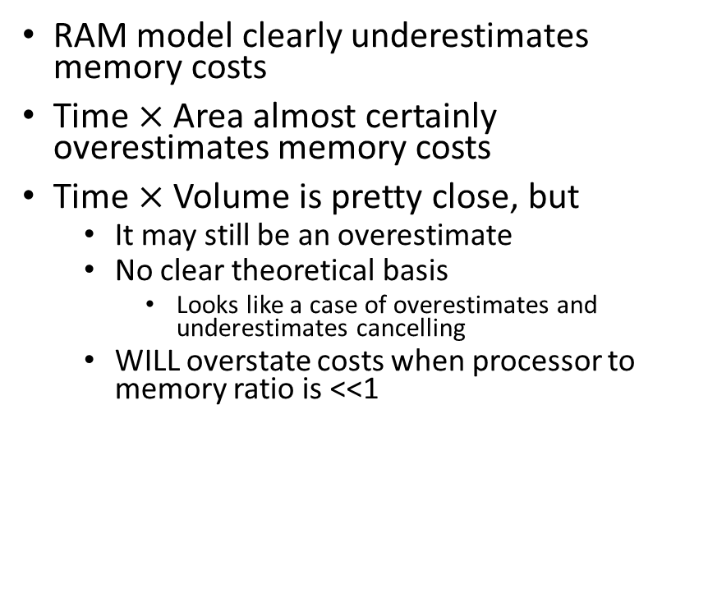
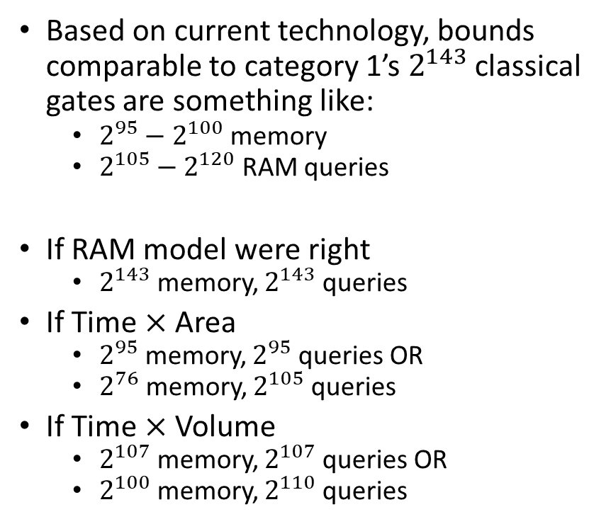
Back to Models
Based on current technology, bounds comparable to category 1’s $2^{143}$ classical gates are something like:
  $2^{95}−2^{100}$ memory
  $2^{105}−2^{120}$ RAM queries
If RAM model were right
  $2^{143}$ memory, $2^{143}$ queries
If Time $×$ Area
  $2^{95}$ memory, $2^{95}$ queries OR
  $2^{76}$ memory, $2^{105}$ queries
If Time $×$ Volume
  $2^{107}$ memory, $2^{107}$ queries OR
  $2^{100}$ memory, $2^{110}$ queries
RAM model clearly underestimates memory costs
Time $×$ Area almost certainly overestimates memory costs
Time $×$ Volume is pretty close, but
  It may still be an overestimate
  No clear theoretical basis
    Looks like a case of overestimates and underestimates cancelling
  WILL overstate costs when processor to memory ratio is <<1

Slide 28
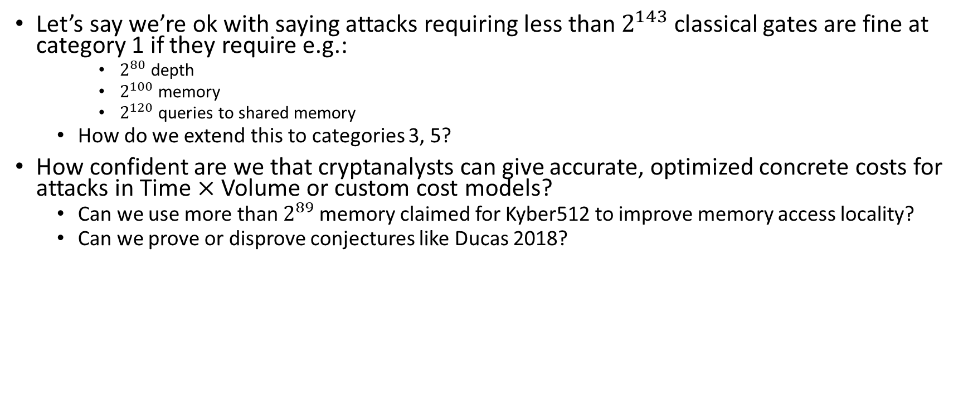
Questions for Discussion
Let’s say we’re ok with saying attacks requiring less than $2^{143}$ classical gates are fine at category 1 if they require e.g.:
    $2^{80}$ depth
    $2^{100}$ memory
    $2^{120}$ queries to shared memory
  How do we extend this to categories 3, 5?
How confident are we that cryptanalysts can give accurate, optimized concrete costs for attacks in Time $×$ Volume or custom cost models?
  Can we use more than $2^{89}$ memory claimed for Kyber512 to improve memory access locality?
  Can we prove or disprove conjectures like Ducas 2018?

Slide 29
References
[Shor 1994] https://arxiv.org/pdf/quant-ph/9508027.pdf
[Kuperberg 2003] https://arxiv.org/abs/quant-ph/0302112
[Kuperberg 2011] https://arxiv.org/pdf/1112.3333.pdf
[Grover 1996] https://arxiv.org/pdf/quant-ph/9711043.pdf
[Beals et al. 2012] https://arxiv.org/abs/1207.2307
[Landauer 1961] https://ieeexplore.ieee.org/document/5392446
[Bennett 1973] https://www.math.ucsd.edu/~sbuss/CourseWeb/Math268_2013W/Bennett_Reversibiity.pdf
[Bennett 1982] http://www.pitt.edu/~jdnorton/lectures/Rotman_Summer_School_2013/thermo_computing_docs/Bennett_1982.pdf
[Fredkin Toffoli 1982] https://link.springer.com/article/10.1007/BF01857727
[Perlner Liu 2017] https://arxiv.org/abs/1709.10510
[Cooper 2015] https://broadbandnow.com/report/much-data-really-cost-isps/
[Corcoran et al. 2020] https://www.nature.com/articles/s41467-020-16265-x
[Ducas 2018] https://eurocrypt.iacr.org/2018/Slides/Monday/TrackB/01-01.pdf

